Slide 1
Electromagnetic Oscillations and Alternating Current
Session 12-13
SCIE6063
COMPUTATIONAL PHYSICS
June 2024

Slide 2
LC Oscillations, Qualitatively
In RC and RL circuits the charge, current, and potential difference grow and decay exponentially.
On the contrary, in an LC circuit, the charge, current, and potential difference vary sinusoidally with period T and angular frequency ω.
The resulting oscillations of the capacitor’s electric field and the inductor’s magnetic field are said to be electromagnetic oscillations.

Slide 4


LC Oscillations,
The energy stored in the electric field of the capacitor at
any time is where q is the charge on the
capacitor at that time.
The energy stored in the magnetic field of the inductor at
any time is where i is the current through
the inductor at that time.
As the circuit oscillates, energy shifts back and forth from one type of stored energy to the other, but the total amount is conserved.

Slide 5


LC Oscillations,
The time-varying potential difference (or voltage) v_{C} that exists across the capacitor C is
To measure the current, we can connect a small resistance R in series with the capacitor and inductor and measure the time-varying potential difference v_{R}
across it:

Slide 6

LC Oscillations
The Electrical Mechanical Analogy:
One can make an analogy between the oscillating LC system and an oscillating block–spring system.
Two kinds of energy are involved in the block–spring system. One is potential energy of the compressed or extended spring; the other is kinetic energy of the moving block.
Here we have the following analogies:

Slide 7




LC Oscillations,
The Block-Spring Oscillator:

Slide 8







LC Oscillations,
The LC Oscillator:

Slide 9





LC Oscillations,
Angular Frequencies:
But
The angular frequency of oscillation for an ideal (resistanceless) LC is:

Slide 10




LC Oscillations,
The electrical energy stored in the LC circuit at time t is,
The magnetic energy is:
But
Therefore
Note that
The maximum values of U_{E} and U_{B} are both Q²/2C.
At any instant the sum of U_{E} and U_{B} is equal to Q²/2C, a
constant.
When U_{E} is maximum, U_{B} is zero, and conversely.

Slide 11
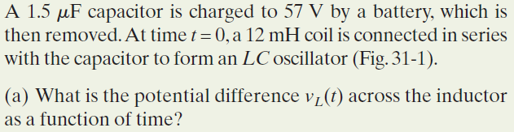
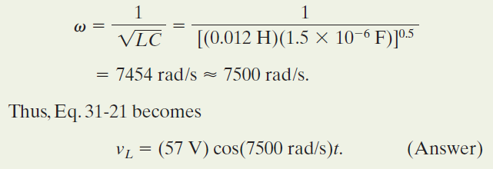
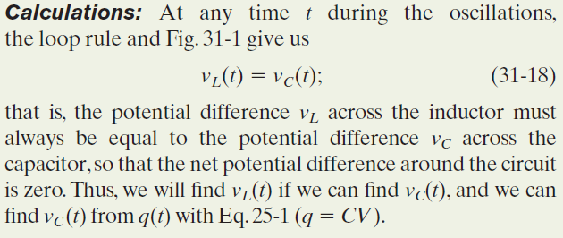

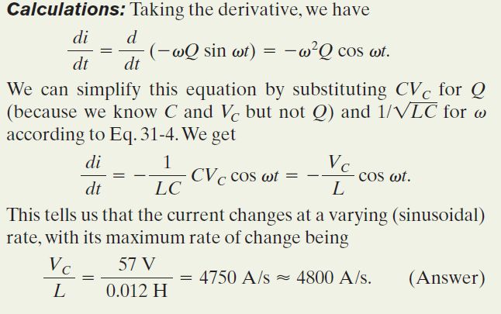
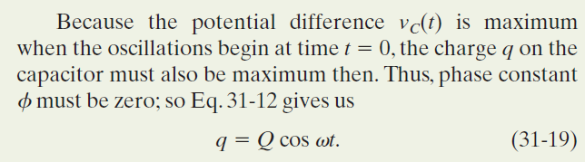

Example, LC oscillator, potential charge, rate of current change

Slide 12
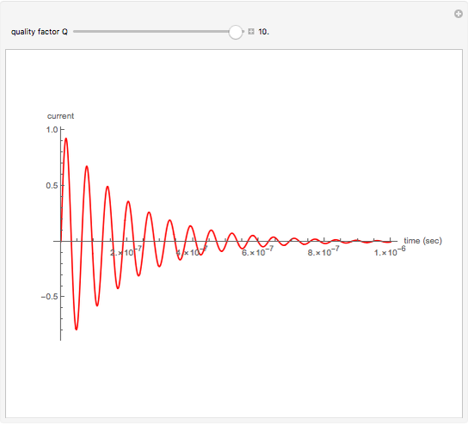
2. Damped Oscillations in an RLC Circuit:
R
L
C
Fig. 1. A series RLC circuit. As the charge contained in the circuit oscillates back and forth through the resistance, electromagnetic energy is dissipated as thermal energy, damping ( decreasing the amplitude of) the oscillations.

Slide 13






Damped Oscillations in
an RLC Circuit: (cont.)
Analysis:
Where
And

Slide 14
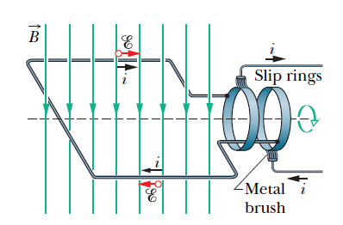


3. Alternating Current
The basic mechanism of an alternating-current generator is a conducting loop rotated in an external magnetic field.
In practice, the alternating emf induced in a coil of many turn of wire is made accessible by means of slip rings attached to the rotating loop. Each ring is connected to one end of the loop wire and is electrically connected to rest of the generator circuit by a conducting brush against which the ring slips as the loop (and it) rotates
Fig.2. An alternating-current generator
ω_{d} is called the driving angular frequency, and I is the amplitude of the driven current.

Slide 15
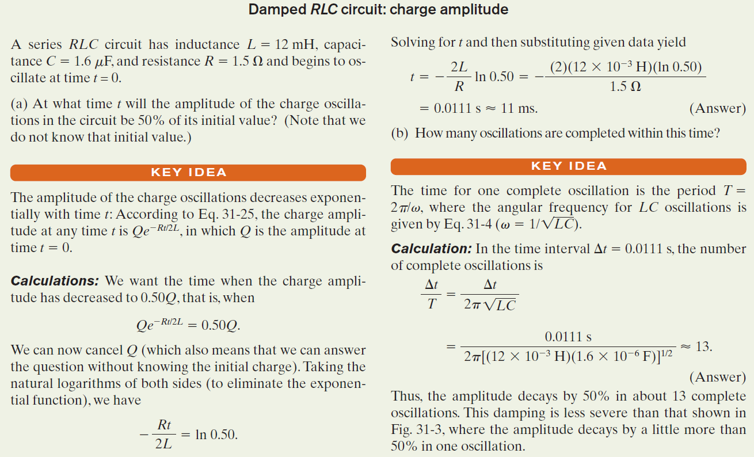

Slide 16
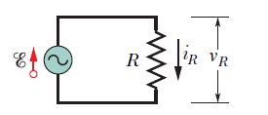

4. Three Simple Circuits:
(1). A Resistive Load:
Fig. 3. A resistor is connected across an alternating-current generator
ε- v_{R} = 0 v_{R} = ε_{m} Sin ω_{d}t = V_{R} Sin ω_{d}t
For a purely resistive load the phase constant φ= 0°.

Slide 17
Three Simple Circuits
Rotation of phasor
at rate ω_{d}
i_{R}
I_{R}
v_{R}
V_{R}
ω_{d}
Gb.4. A Diagram Phasor of V_{R} and I_{R}

Slide 18
Three Simple Circuits
Example, Purely resistive load: potential difference and current
In the figure, resistance R is 200 Ω and sinusoidal alternating emf device operates at amplitude ϵ_{m}= 36 V and frequency f_{d}=60,0 Hz.
What is the potential difference v_{R}(t) across the resistance as a function of time t and what is the amplitude V_{R} of v_{R}(t)?
Fig. 5. A resistor is connected across an alternating-current generator

Slide 19

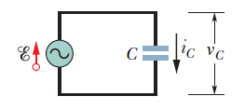



Three Simple Circuits:
(2). A Capacitive Load:
Fig. 6. A capacitor is connected across an alternating-current generator
X_{C} is called the capacitive reactance of a capacitor. The SI unit of X_{C} is the ohm, just as for resistance R.

Slide 20




Three Simple Circuits:

Slide 21
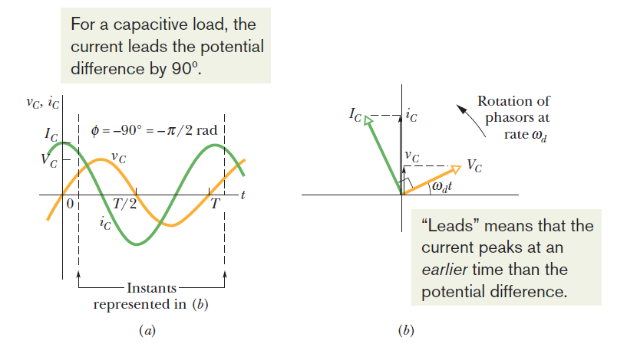
Three Simple Circuits:
Fig.7. (a) The current in the capacitor leads the voltage by 90⁰ (π/2 rad)
(b) A phasor diagram shows the same thing.

Slide 22
Three Simple Circuits:
Example, Purely capacitive load: potential difference and current
In the figure, capacitance C is 15,0 µF and the sinusoidal alternating emf device operates at amplitude ε_{m} =36,0 V and frequency f_{d}=60,0 Hz.
a). What are the potential difference v_{C}(t) across the capacitance and the amplitude V_{C} of v_{C}(t)?
b). What are the current i_{C}(t) in the circuit as a function of time and the amplitude I_{C} of i_{C}(t) ?

Slide 23








Three Simple Circuits
(3). An Inductive Load:
ε
~
L
V_{L}
i_{L}
Fig. 8. An inductor is connected across an alternating current generator
Notes:
is the ohm,

Slide 24
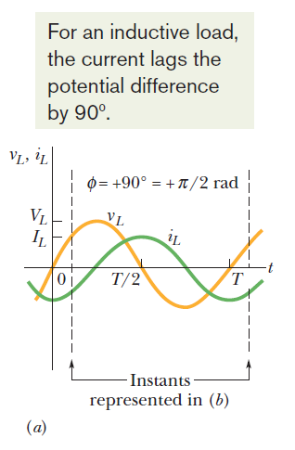
Three Simple Circuits:
Rotation of phasors at rate ω_{d}
v_{L}
V_{L}
ω_{d}
i_{L}
I_{L}
Fig.9. (a) The current in the inductor lags the voltage by 90⁰(=π/2 rad). (b) A phasor diagram shows the same thing.

Slide 25
Three Simple Circuits:
ε
Example, Purely inductive load
~
L
VL
iL
In fig. Inductance L is 230 mH and the sinusoidal alternating emf device Operates at amplitude εm =36 V and frequency fd = 60 Hz.
What are the potential difference VL(t)?
What are the current iL(t) in the circuit as a function of time
and the amplitude I of iL(t)?
Fig. 10. An inductor is connected across an alternating current generator

Slide 26
Table 1. Phase and Amplitude Relations for Alternating currents and Voltages
Circuit Element | Symbol | Resistance or Reactance | Phase of Current | Phase Constant (or angle) ф | Amplitude Relation
Resistor | R | R | In phase with V_{R} | 0⁰(=0 rad) | V_{R}=I_{R} R
Capacitor | C | X_{C}= 1/(ω_{d}C) | Leads V_{C} by 90⁰ (=π/2 rad) | -90⁰(=-π/2 rad) | V_{C}=I_{C} X_{C}
Inductor | L | X_{L}= ω_{d}L | Lags V_{L} by 90⁰ (=π/2 rad) | +90⁰(=+π/2 rad) | V_{L}=I_{L} X_{L}

Slide 27
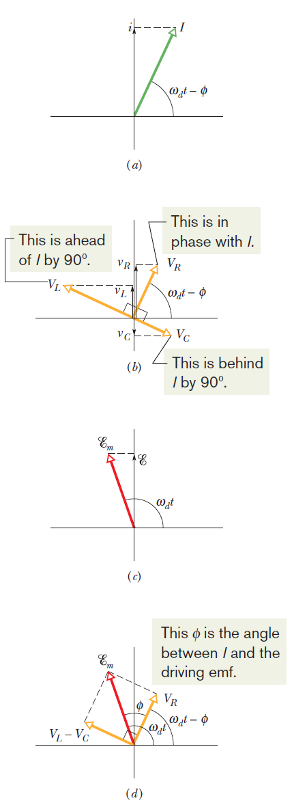
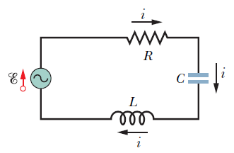
5. The Series RLC Circuit
Fig. 11. (a) A phasor representing the alternating current in the driven RLC circuit at time t. The amplitude I, the instantaneous value i, and the phase(ω_{d}t -φ) are shown. (b) Phasors representing the voltages across the inductor, resistor, and capacitor, oriented with respect to the current phasor in (a).

Slide 28
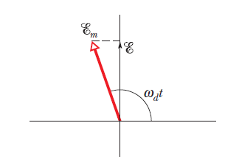
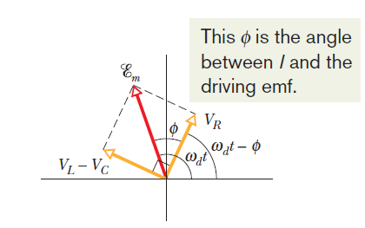
The Series RLC Circuit
Fig.11.
(c) A phasor representing the alternating emf that drives the current of (a).
(d) The emf phasor is equal to the vector sum of the three voltage phasors of (b).Here, voltage phasors V_{L} and V_{C} have been added vectorially to yield their net phasor (V_{L}-V_{C}).
(c)
(d)

Slide 29






The Series RLC Circuit

Slide 30


The Series RLC Circuit

Slide 31




6. Power in Alternating Current Circuits:
The instantaneous rate at which energy is dissipated in the
resistor:
The average rate at which energy is dissipated in the resistor,
is the average of this over time:
Since the root mean square of the current is given by:
Similarly,

Slide 32




Power in Alternating Current
Circuits (cont.)
Where

Slide 33
Example,
Driven RLC circuit:
A series RLC circuit, driven with ε_{rms}=120 V at frequency f_{d}=60 Hz, contains a resistance R=200 Ω, an inductance with inductive reactance X_{L}=80 Ω, and a capacitance with capacitive reactance X_{C}= 150 Ω.
What are the power factor cosф and phase constant ф of the circuit?
What is the average rate P_{avg} at which energy is dissipated in the resistance?
What new capacitance C_{new} is needed to maximize P_{avg} if the other parameters of the circuit are not changed?

Slide 34
Assignment
Do the problems in the text-book:
Fundamental of Physics, Chapter 31 (Electromagnetic Oscillation and Alternating Current); p.935-940
Problems No. 3, 13, 29, 44, 53, 59, and 68

Slide 35
These slides have been adapted from
Halliday D.; Resnick R. and Walker J. (2018). Fundamentals Of Physics ,Extended,
11th , John Wiley & SONS Inc, New York, ISBN: 9781119306856
Chapter 31
Bina Nusantara

